Slide 1
OPC-UA in Context of IIoT
Dr. Binil Starly
James T. Ryan Professor
Edward P. Fitts Department of Industrial & Systems Engineering
Notes:
https://www.linkedin.com/learning/programming-foundations-databases-2/relational-databases-2?u=53565897

Slide 2


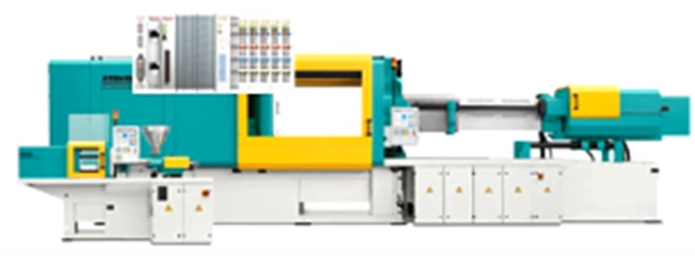
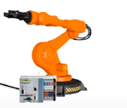
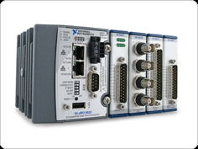
7
OPC-UA vs Profinet
Enterprise Level
BI
MES
ERP
OPC UA Client
OPC UA Client
OPC UA Client
OPC UA Client
OPC UA Server
OPC UA Server
Historian
Operations
Level
Command & Control
SCADA
OPC UA Client
OPC UA Client
OPC UA Server
OPC UA Server
OPC UA Server
Plant Floor Level

Slide 3
7
Profinet
Enterprise Level
BI
MES
ERP
OPC UA Client
OPC UA Client
OPC UA Client
OPC UA Client
OPC UA Server
OPC UA Server
Historian
Operations
Level
Command & Control
SCADA
OPC UA Client
OPC UA Client
OPC UA Server
OPC UA Server
OPC UA Server
Plant Floor Level

Slide 4
7
OPC-UA
Enterprise Level
BI
MES
ERP
OPC UA Client
OPC UA Client
OPC UA Client
OPC UA Client
OPC UA Server
OPC UA Server
Historian
Operations
Level
Command & Control
SCADA
OPC UA Client
OPC UA Client
OPC UA Server
OPC UA Server
OPC UA Server
Plant Floor Level

Slide 5
7
OPC-UA vs Profinet Summary
 | PROFINET | OPCA UA
Cycle Time | Between 0.125 – 512 ms | ~200ms, depending on server and connection
Jitter | 0.0001 – 1 ms | 10 – 100 ms
Data Format | Tightly defined data format | Object oriented complex information model
Physical Length | Limited (by Cable Length) | Unlimited
Network Boundaries | It not forwarded to network routers or jump between various networks | Specifically designed to be going through network routers and various business networks
Cyclic Data Exchange | Guaranteed Performance | Best Effort Performance

Slide 6




7
OPC-UA vs MQTT
Publish 3 bar
Publish 3bar
MQTT Client
Pressure Gauge
MQTT Broker
Publish 3 bar
MQTT Pub-Sub Pattern
MQTT Client

Slide 7
7
OPC-UA vs MQTT
Request-Response Pattern
+
Pub-Sub Pattern (relies on MQTT protocol)
OPC UA Client
Command & Control
OPC UA Server

Slide 8
7
OPC-UA vs MQTT
 | OPC UA | MQTT
Communication Type | Request – Response + Pub-Sub Pattern | Only Pub-Sub Pattern
Openness | Open but must join the OPC-Foundation (a club) | Completely OPEN Protocol. Do not have to pay to use it.
Bandwidth (Data Packet) | Significant (50X than MQTT) | Low bandwidth Consumption (1X)
Unified Namespace | YES (through node addresses + tags) | YES ( through topic + tag names)
Data Format | Standard Format and hence inflexible | Unspecified Format. Subscriber must know how to decipher the format
Memory Consumption on Devices | High | Low
Data Subscribers | Limited | Almost unlimited

Slide 9
In Summary
Profinet
Really useful for inter-device communication at short distances for real-time control
OPC/UA
Communication with higher level IT Systems
Can be expensive to implement
Mainly Poll-Response mode of communication
MQTT
Low bandwidth, memory efficient communication between devices
Unstructured format makes it flexible and extensible
Low cost implementation with thousands of field assets connected

